Slide 1
PROCESS CONTROL IN LINUX

Slide 2
Process Related Command in Linux
ps //
kill
killall
top
pstree
linux-command &
nice

Slide 3
System Calls related with Processes
Name | Description
fork | Creates new process
exit | Terminates process execution
wait | Synchronization of parent process with exit of child process.
exec | Allows a process to invoke a new program, overlaying its address space with executable image of a file.
brk | Allows a process to allocate more memory dynamically.

Slide 4
Process Creation
pid=fork( )
Parent process invokes this system call
Newly created process is called child process.
On return form this system call, both the processes have identical copies of their user-level context except for the return value pid [process id].

Slide 5
In the parent process, pid is the child process ID.
In the child process , pid is zero.
Process 0 ( init ) , created internally by the kernel when the system is booted.
It is the only process not created via fork.

Slide 6
The kernel does the following sequence of operations for fork.
It allocates a slot in the process table for the new process.
It assigns a unique ID number to the child process.
It makes a logical copy of the context of the parent process.
It increments file and inode table counters.
It returns the ID number of the child to the parent process, and a 0 value to the child process.

Slide 7
Check Process status
#include<stdio.h>
#include<stdlib.h>
int main()
{
printf(“Running ps through system”);
system(“ps –ax”);
exit(0);
}
# gcc prg.c –o prg
#./prg

Slide 8
# include <stdio.h>
# include <unistd.h> /* contains fork prototype */
int main(void)
{
printf("Hello World!\n");
fork( );
printf("I am after forking\n");
printf("\tI am process %d.\n", getpid( ));
}

Slide 9
When this program is executed, it first prints Hello World! When the fork is executed, an identical process called the child is created.
Then both the parent and the child process begin execution at the next statement.
When a fork is executed, everything in the parent process is copied to the child process.
This includes variable values, code, and file descriptors.
Following the fork, the child and parent processes are completely independent.
A parent process can be distinguished from the child process by examining the return value of the fork call.
Fork returns a zero to the child process and the process id of the child process to the parent.

Slide 10
#include <stdio.h>
#include <unistd.h> /* contains fork prototype */
int main(void)
{
int pid;
printf("Hello World!\n");
printf("I am the parent process and pid is : %d .\n",getpid());
printf("Here i am before use of forking\n");
pid = fork();
printf("Here I am just after forking\n");
if (pid == 0)
printf("I am the child process and pid is :%d.\n",getpid());
else
printf("I am the parent process and pid is: %d .\n",getpid());
}

Slide 11
#include <stdio.h>
#include <unistd.h> /* contains fork prototype */
# include<sys/types.h>
int main(void) {
int pid, a, b, c;
printf(“Enter Values of a, b :\n");
scanf(“%d%d”, &a,&b);
pid = fork();
if (pid == 0)
{
printf("I am the child process and pid is :%d.\n",getpid());
c = a + b;
printf(“\nAfter Addition: %d”, c);
}
else
{ printf("I am the parent process and pid is: %d .\n",getpid());
c = a – b;
printf(“\nAfter Subtraction: %d”, c);
}
}

Slide 12
# gcc prg.c –o prg
#./prg

Slide 13
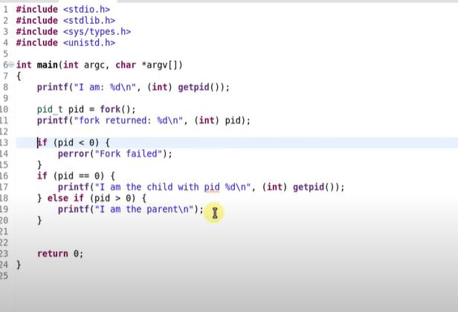

Slide 14
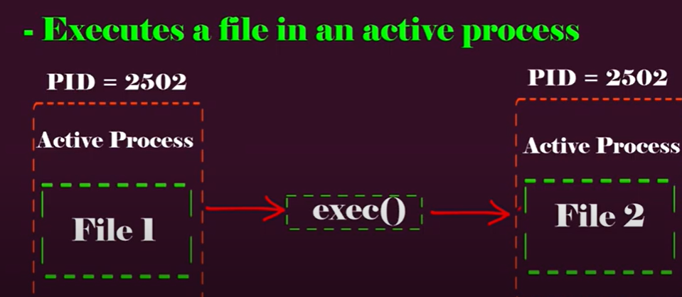
Exec system call

Slide 15
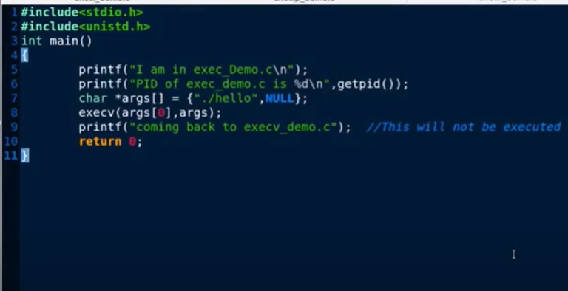
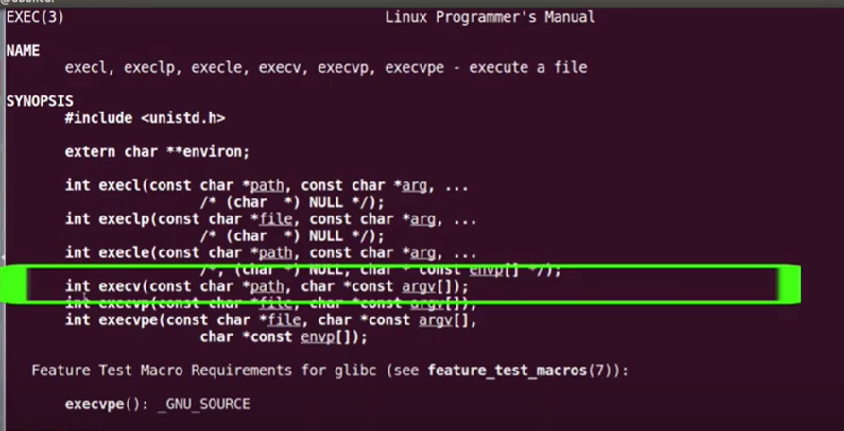
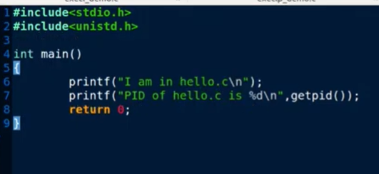
File1
File2

Slide 16
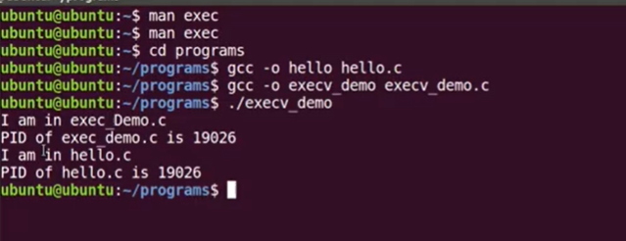

Slide 17
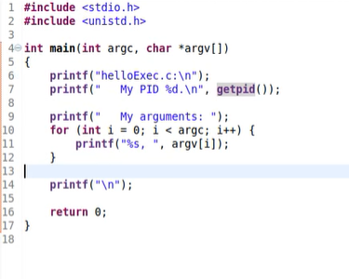
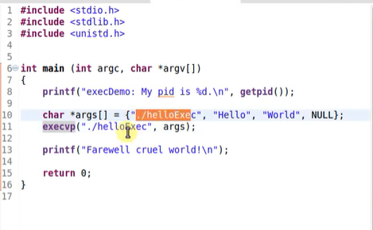
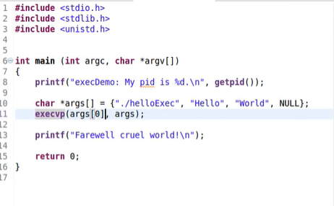

Slide 18

Shortest Job First Scheduling Algorithm | pseudocode

Slide 19
ALGORITHM for SJF Non Preemptive
Firstly Start process.
Declare array size ie. A[10].
Take number of elements to be inserted.
Select process which have shortest burst time Among all process will execute first.
If process have same burst time length then FCFS ( First come First Serve ) scheduling algorithm used.
Make average waiting time length of next process.
Start with first process, selection as above and other processes are to be in queue.
Calculates Burst total number of time.
Display the Related values.
Now Close / Stop process

